Slide 1
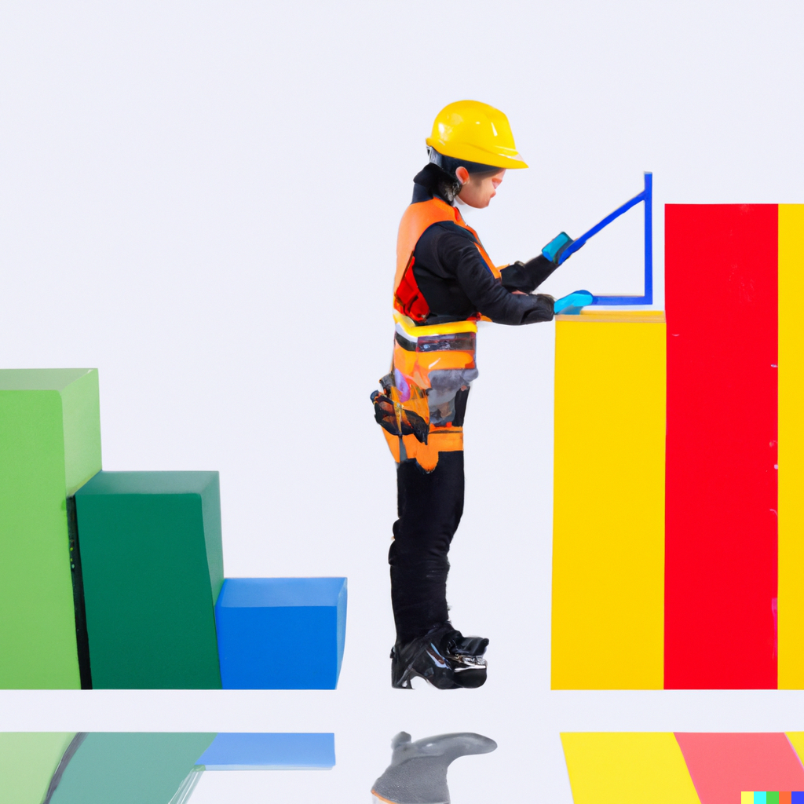
This post is a work in progress
Notes:
AI generated image (so a bit wonky) of a person in construction hi-viz gear standing amongst the colourful bars of a bar chart, holding an angle measure. Their construction boots have a snazzy little heal and there is a reflection on the ground. The text: "This post is a work in progress" has been added in the top right corner. This image was created using DALLE-2 with the prompt: "a construction worker working on a 3d bar chart that looks like a building"

Slide 2
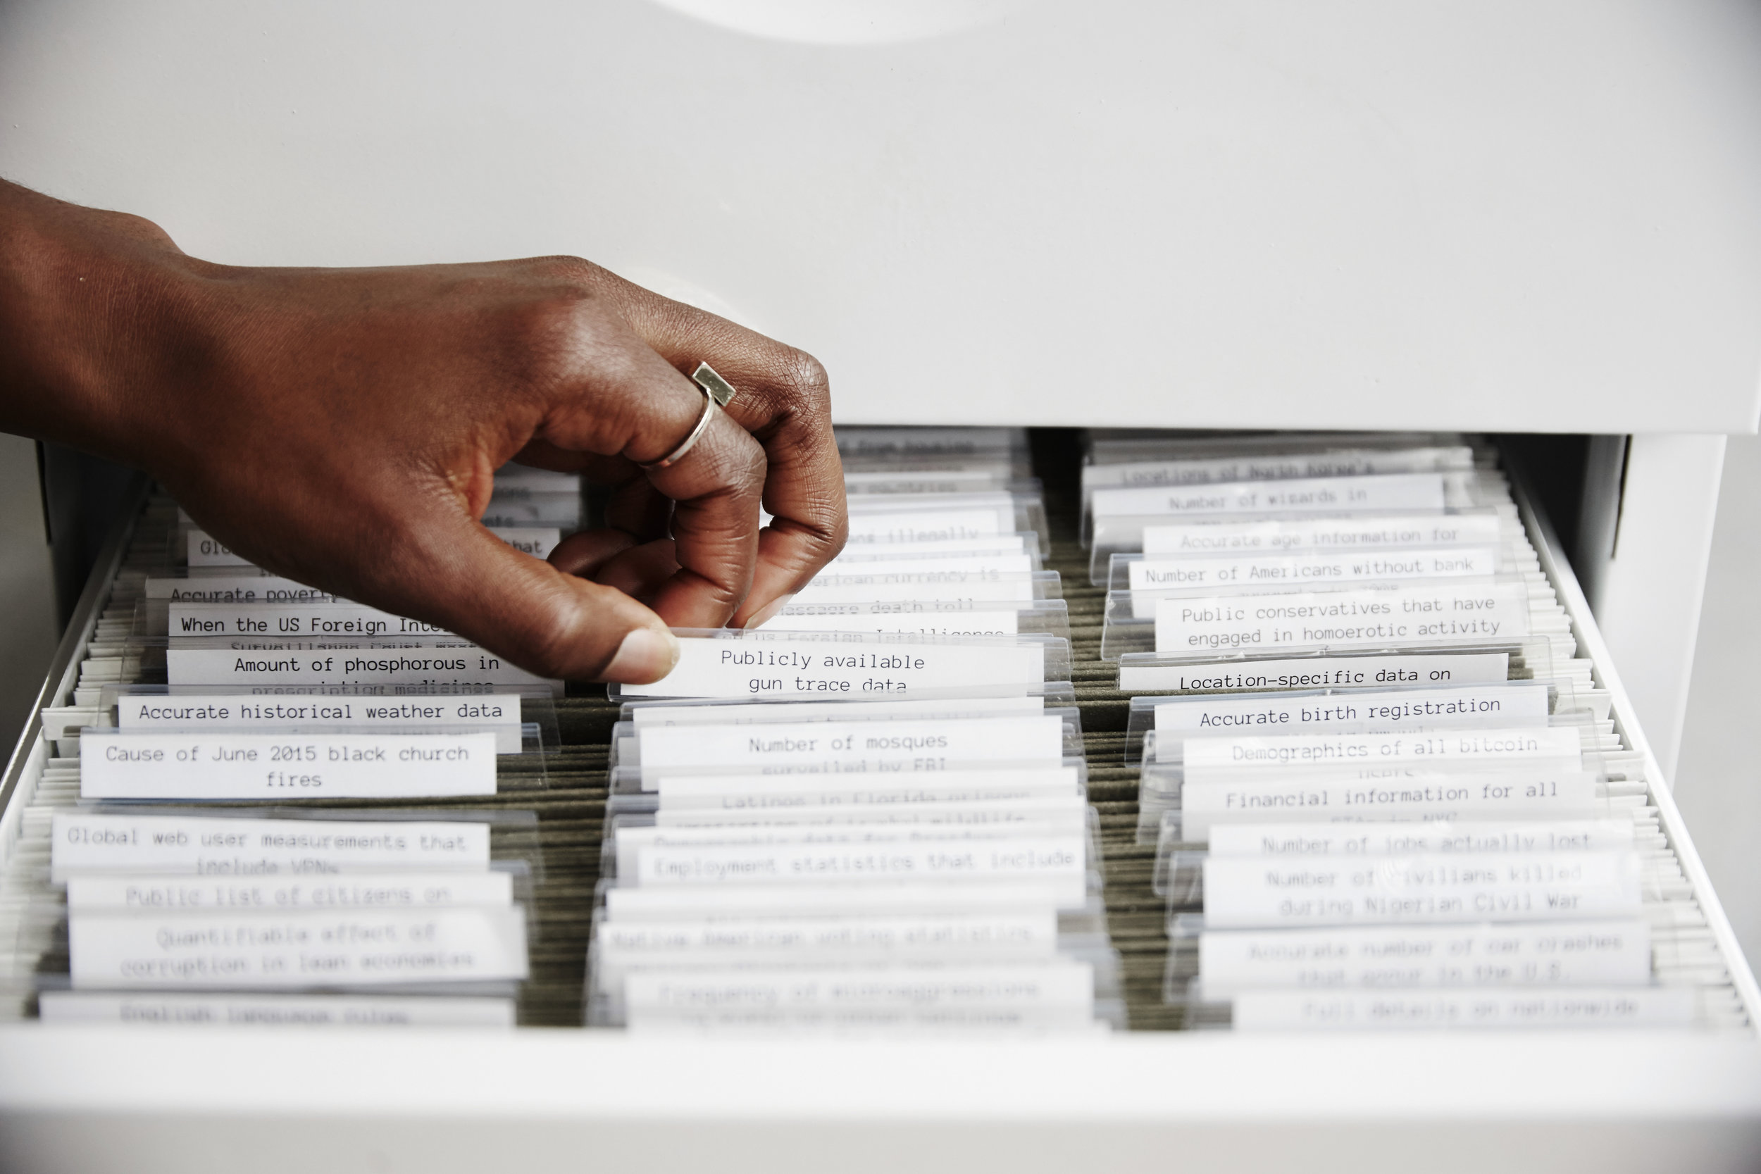

Slide 3
Means (to an an end)
(Data as the focus)
Middle - Realistically, most data if you look properly
Means to an an end
(Data missing)
Means to an end
(Data not the focus)

Slide 4
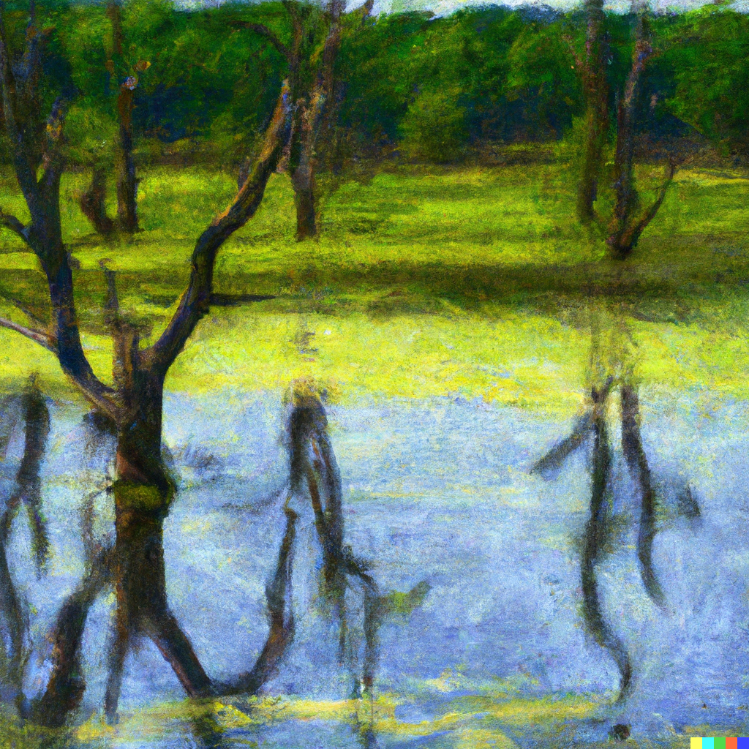
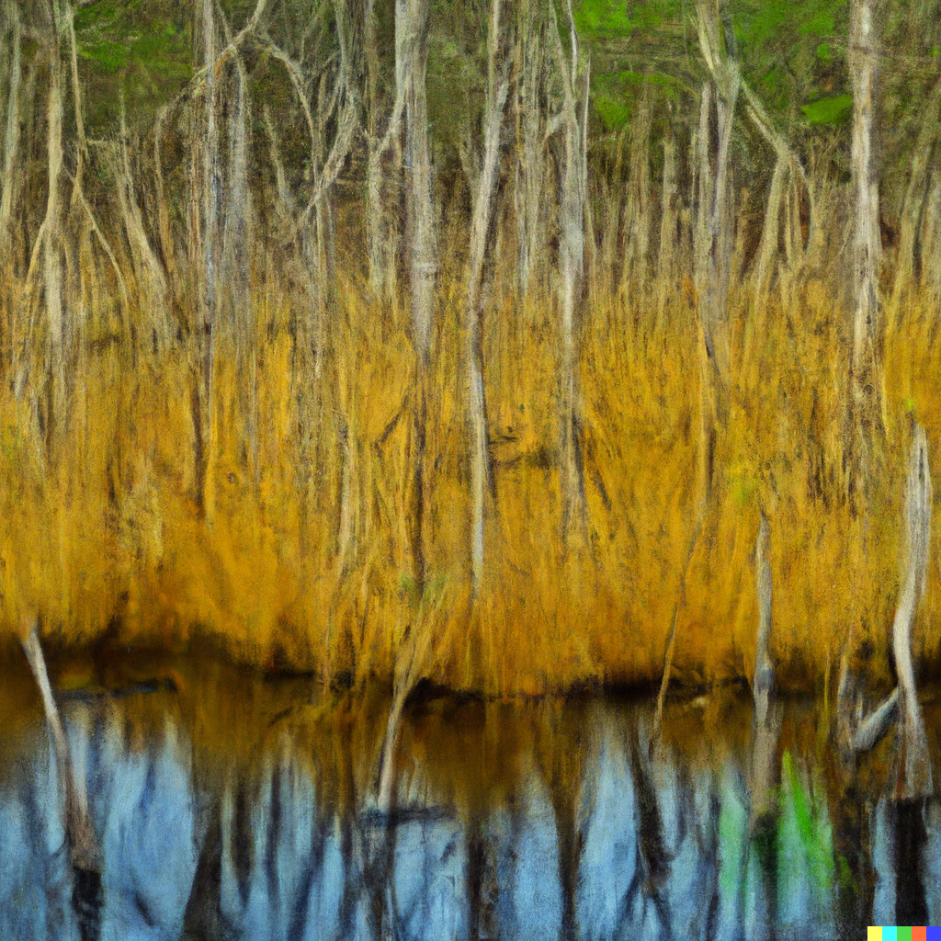
Bog of overconfidence
Bog of disbelief

